Slide 1


Team World Wide
Big Data Hackathon

Slide 2
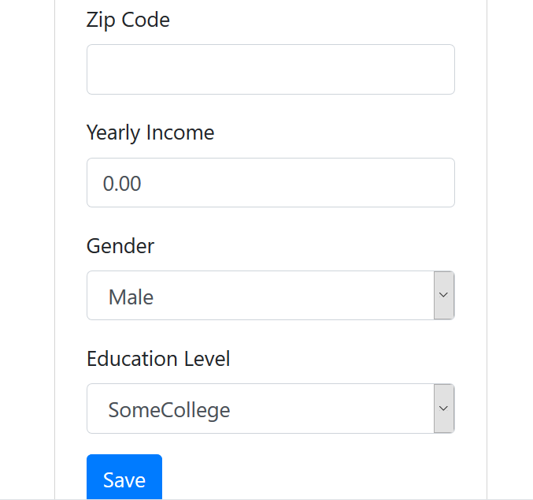
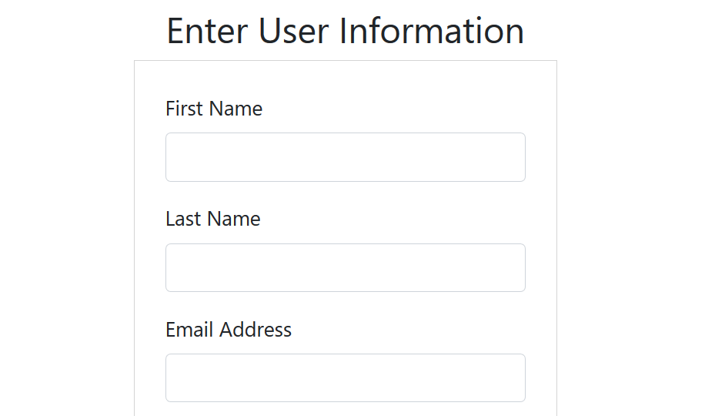
Idea behind Web Application

Slide 3
Idea behind Web Application
https://github.com/JM-GITHUB-23/BigData
This web application was supposed to allow users to enter their personal data and then have relevant transportation and money estimates pulled.
The goal was to combine personal commute data with information from various datasets and perhaps even google maps to show estimated costs to the user.
Some of the estimated costs
* estimate time stuck in traffic
* estimate mileage costs
* health costs
* carbon footprint

Slide 4
Focus
REDUCING CARBON FOOTPRINT

Slide 5
How
We wanted people to use the application for checking which street parking spaces were available.
It will locate parking meters in real-time which ones are vacant and users will be able to see which streets to go first to find parking.
This will reduce the need to wonder around the town looking for a parking space and help make decision of driving or taking public transport.

Slide 6
Data
The data was from around Downtown San Diego area.
We used the transaction time and transaction amount (in cents) to check how long people are typically staying for based on time of day.

Slide 7
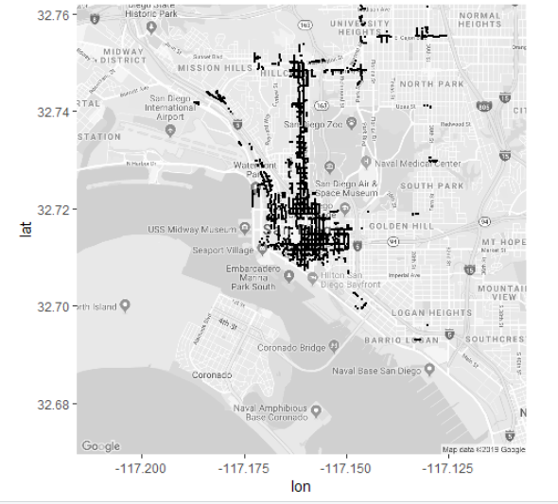

Slide 8
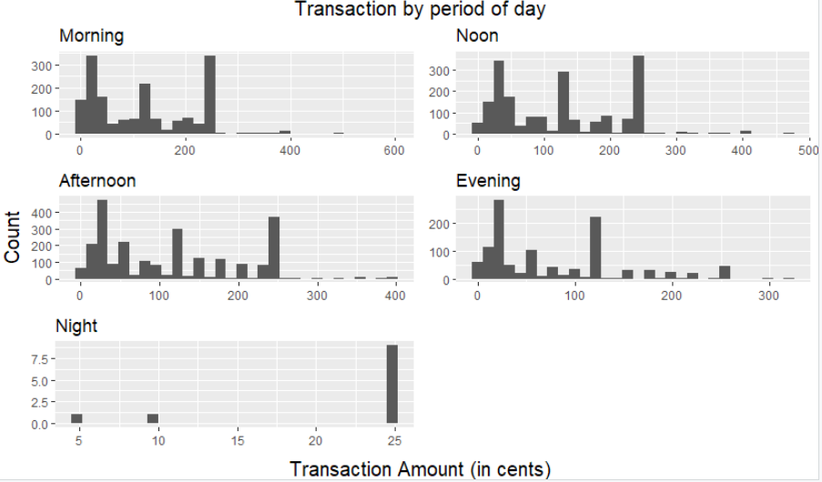

Slide 9
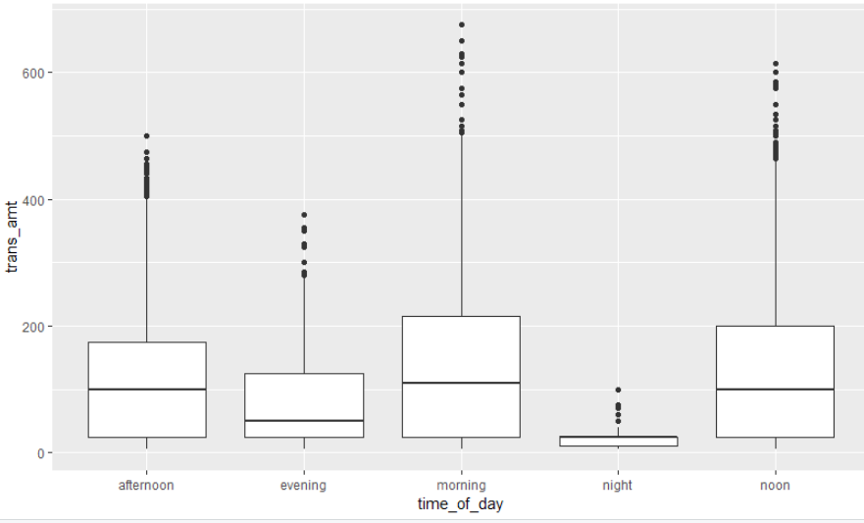

Slide 10
$1.25 = 1 hour
Average of transaction amount in the morning
121.7834 = $1.22
Average of transaction amount in the noon
119.1045 = $ 1.19
Average of transaction amount in the afternoon
113.4936 = $1.13
Average of transaction amount in the evening
81.42927 = $0.81
Average of transaction amount in the night
20.2761 = $0.20

Slide 11
Using this, we may be able to exponentialize pricing or reduce max parking times to create a better flow.
This will make it so that street parking spaces will be utilized for those who need to make a quick stop and encourage those who want to stay longer to make use of the parking structures / lots already built.

Slide 12
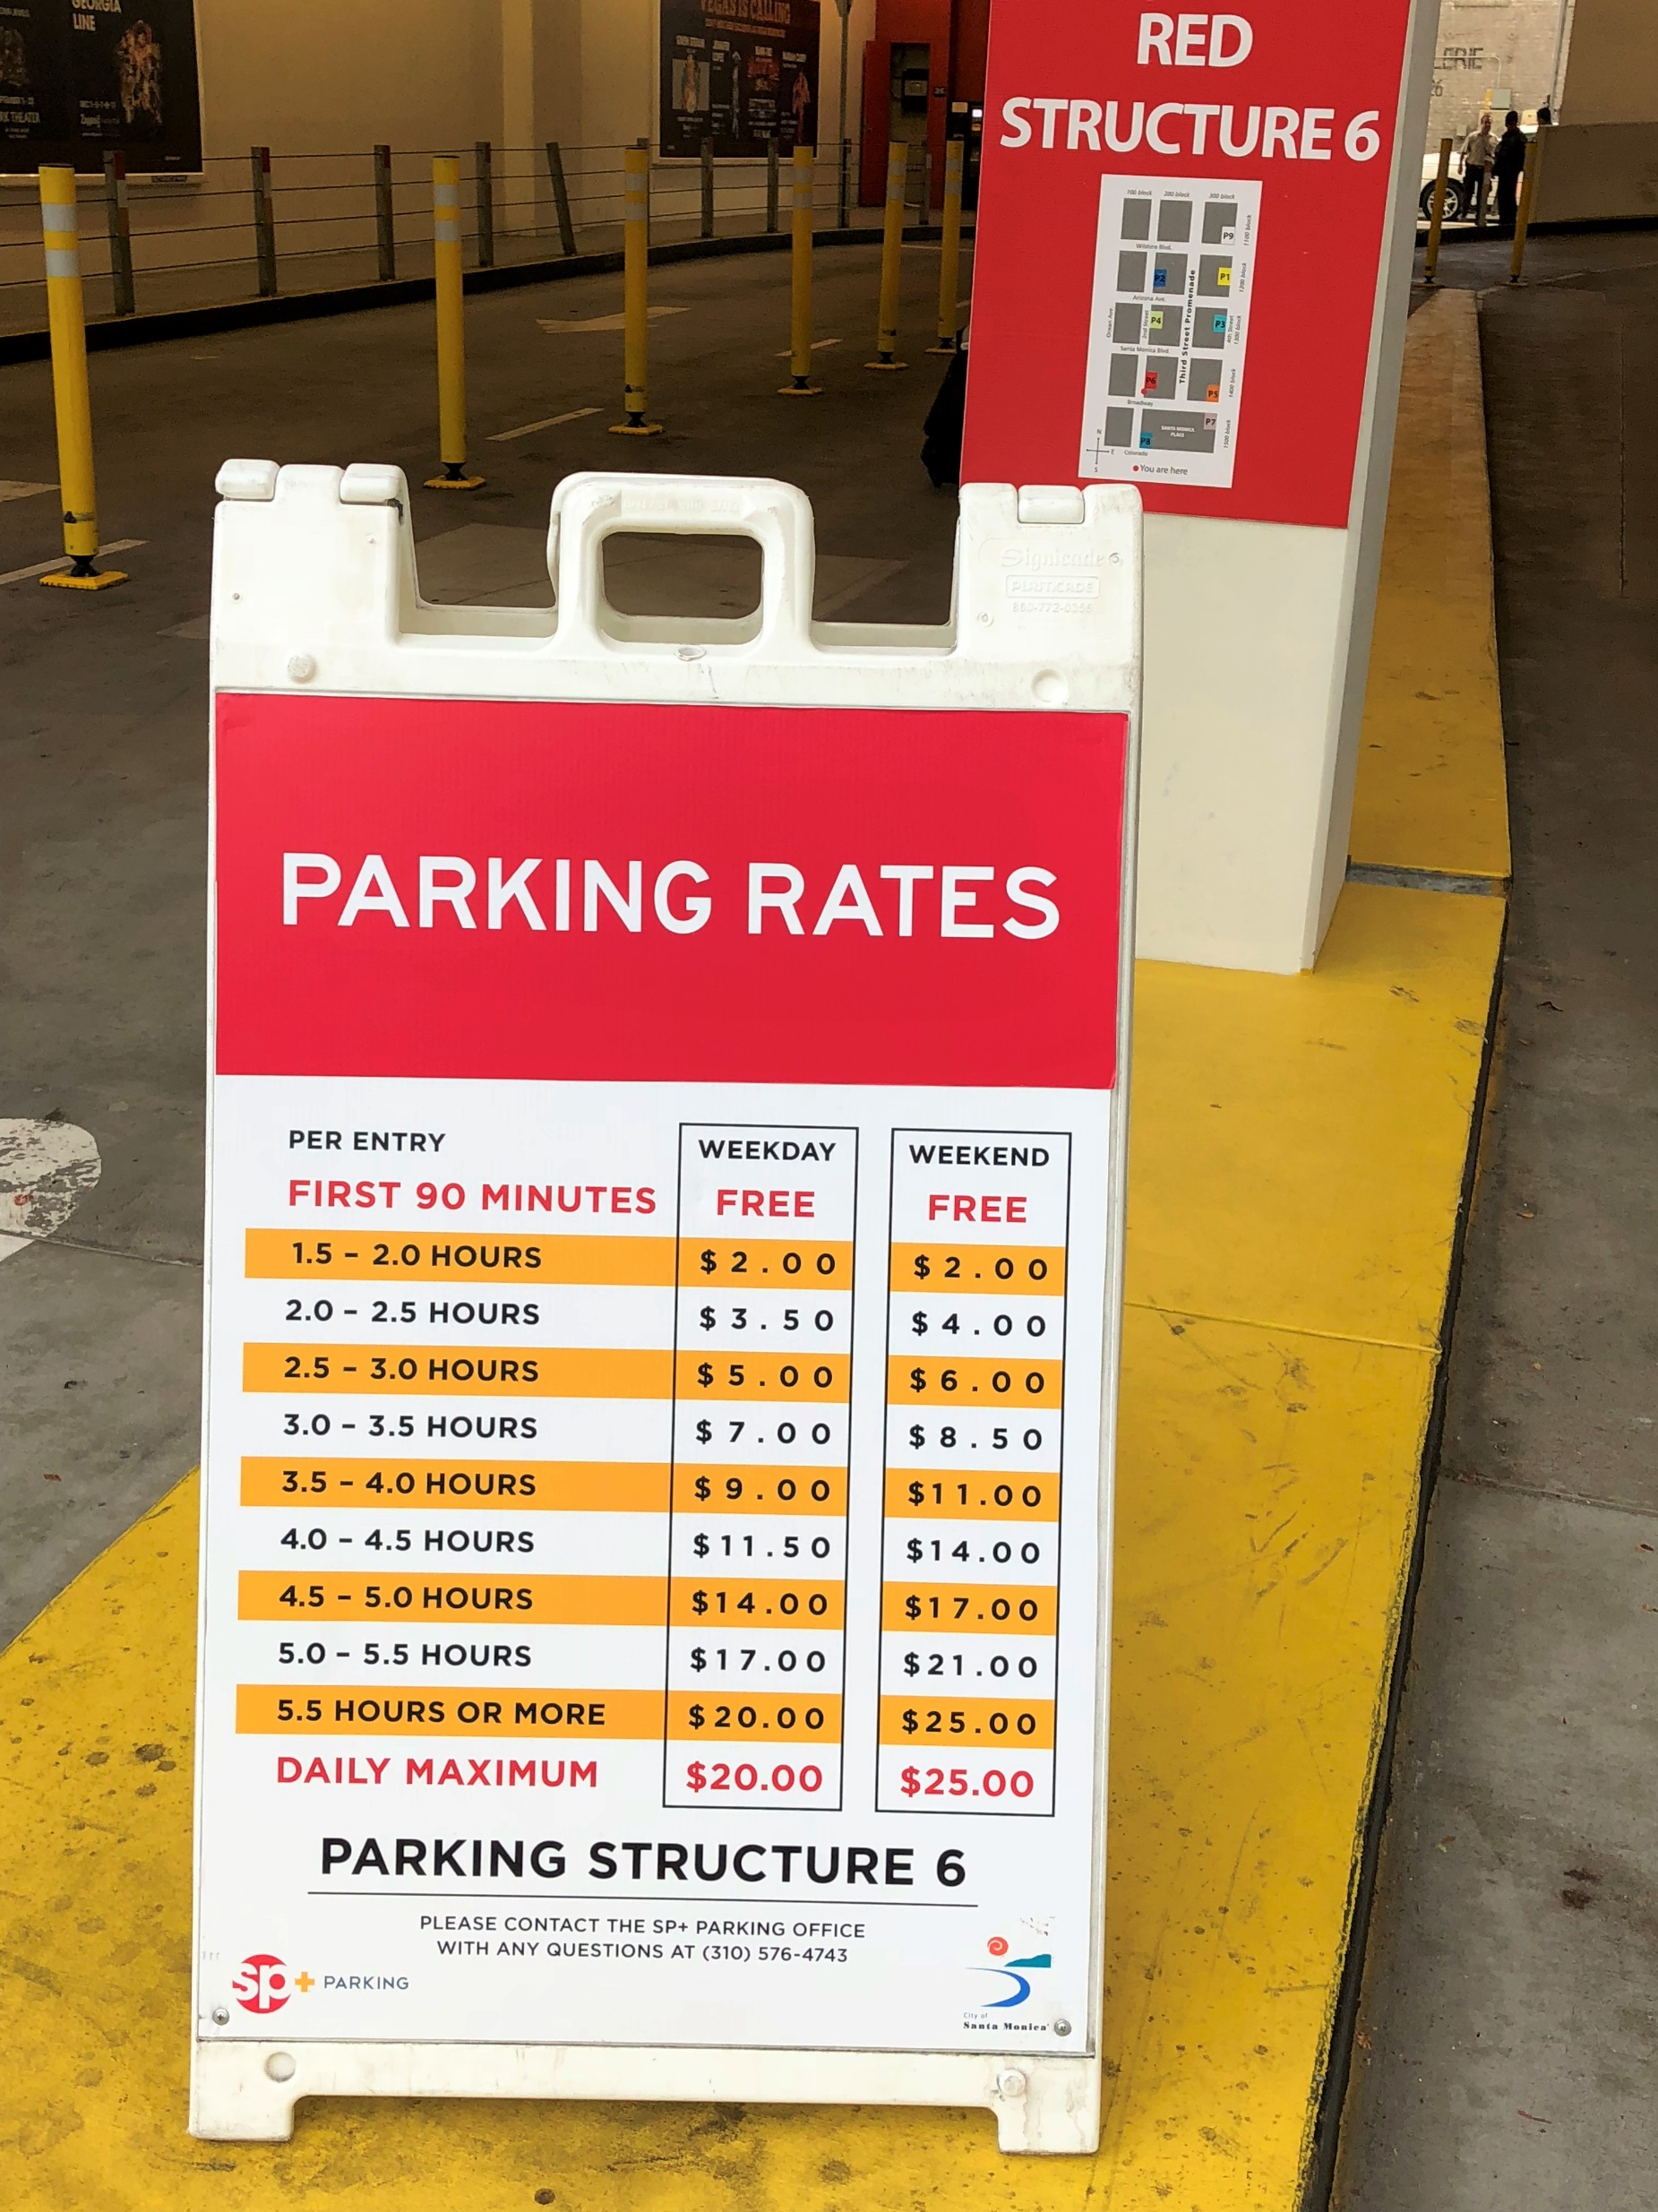

Slide 13
We also wanted to analyze which part of town needs more parking spaces based on the availability and popularity of the current parking meters.
Using this, we may be able to find which part of town requires electric charging spots.
This will incentivize people to drive electric cars.

